Slide 1


Discussion Paper for GCS Meeting
11/Oct/2017
Hitachi, Ltd.

Slide 2
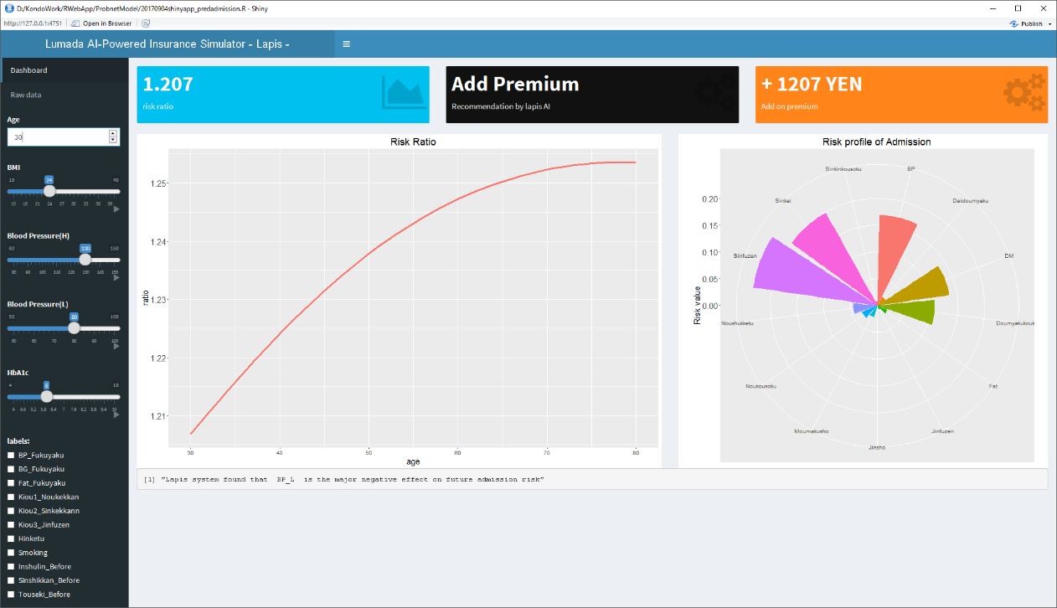
Progress check (Last week's task)
Understanding of simulator environment prototyped by Hitachi
I will pass you the database schema information. Please build it.
Please generate dummy data and import it
I will pass the above prototype source code. Please start up and understand the contents

Slide 3
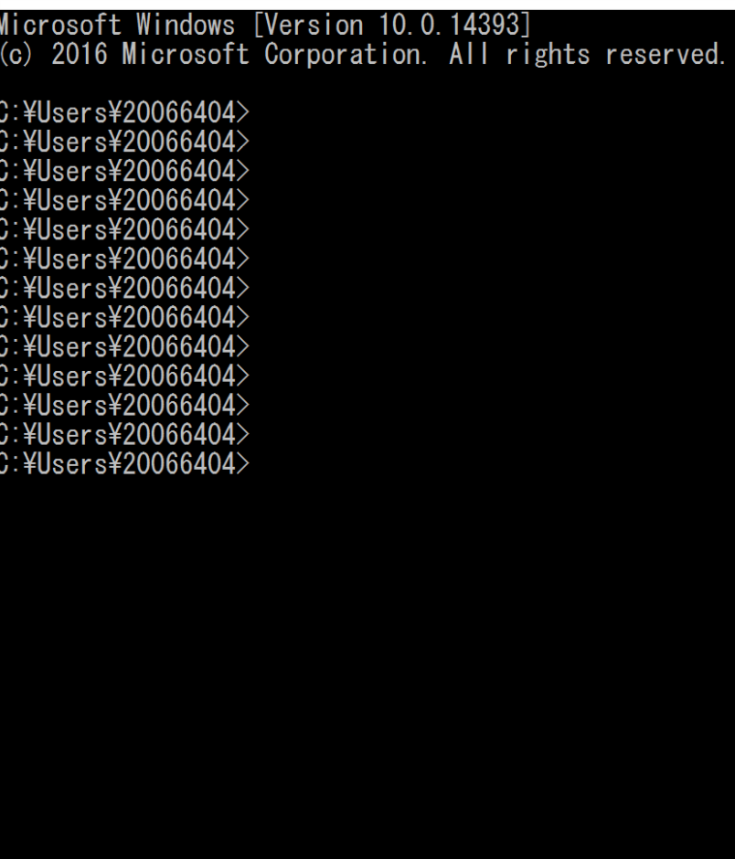
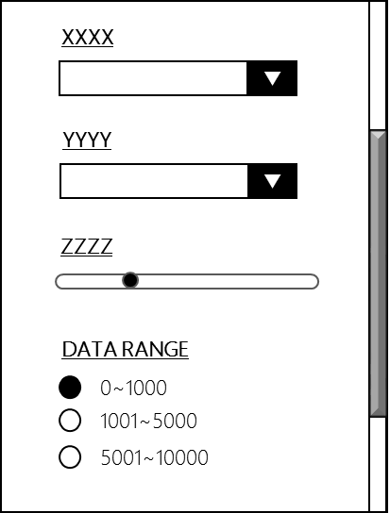
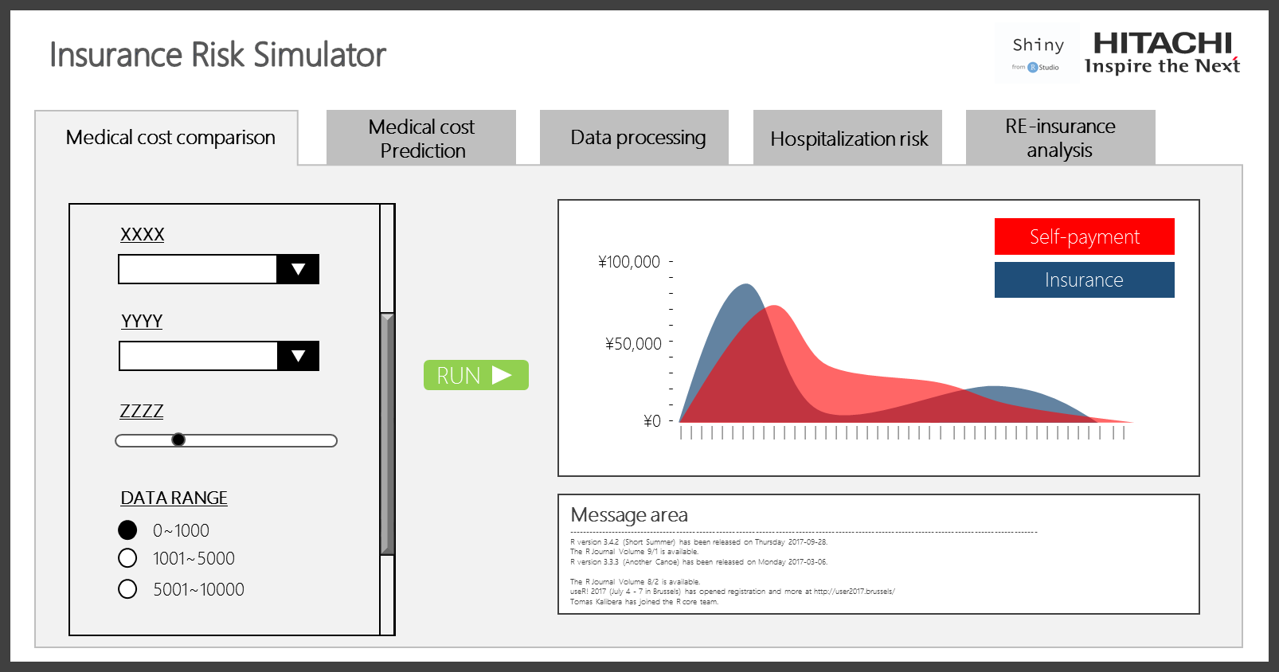
What we want to do on Shiny
Our Requests or confirmation items for simulator development using Shiny
1. Shiny‘s flexibility check
2. Simulator as exe-file & license issue
3. Command line interface → GUI
Simulator.exe
run
API etc..
HTML
CSS
JS
Other
System
Please prepare some sort of GUI components(e.g. text box, combo-box, slider input, radio button…).
The components should be associated with R function(e.g. predictive model, query) as a input parameter.
Please check whether it can be executed even in environments where R and Shiny are not installed.
Please report about license information for commercial use.
Please check if it is possible to apply HTML/CSS on shiny platform
instead of Shiny code

Slide 4
This Week’s work
# | Item | Description
1 | Shiny‘s flexibility check | Confirm flexibility of application development on Shiny platform Can incorporate HTML,CSS and JS freely? Can connect with an external system or API? Try to obtain data from an appropriate external service, store it in a database, or write a program to display Please write a program that calls an external Free-API service and displays information http://smsurf.app-rox.com/api/ Please report if there is any problem
2 | Survey on Simulator as exe-file | We want to be able to run even in environments where R and Shiny are not installed. Please check whether it is possible. If we can run it even in an environment where Shiny is not installed, please investigate Shiny's license.

Slide 5



(Repeated) UI sample and request
Overall UI design
Insurance Risk Simulator
Switching tabs according to function
Medical cost comparison
Medical cost
Prediction
Data processing
Hospitalization risk
RE-insurance
analysis
Data Setting Panel
XXXX
Self-payment
Create SQL according to selected items
\100,000
▼
-
-
-
-
-
-
-
-
-
-
-
Insurance
YYYY
combo box etc.
▼
\50,000
Interactive!
(Plotly)
Deliver SQL
RUN
ZZZZ
\0
| | | | | | | | | | | | | | | | | | | | | | | | | | | | | | | | | | | | | | | | | | |
DATA RANGE
Message area
----------------------------------------------------------------------------------------------------------------------------------------------
R version 3.4.2 (Short Summer) has been released on Thursday 2017-09-28.
The R Journal Volume 9/1 is available.
R version 3.3.3 (Another Canoe) has been released on Monday 2017-03-06.
The R Journal Volume 8/2 is available.
useR! 2017 (July 4 - 7 in Brussels) has opened registration and more at http://user2017.brussels/
Tomas Kalibera has joined the R core team.
0~1000
The plot is different depending on the purpose
--bar graph
--Line graph
--pie chart
--histogram
--Scatter plot
etc…
1001~5000
5001~10000
Draw analysis results
Analysis logic
(Prepared by Kondo , or Please create dummy logic)

